Slide 1
Feeling Safe
Findings of a collaborative
research project
Dr Fiona Sherwood-Johnson, Kathryn Mackay, Dr Corinne
Greasley-Adams and members of Ceartas advocacy, June 2019

Slide 2
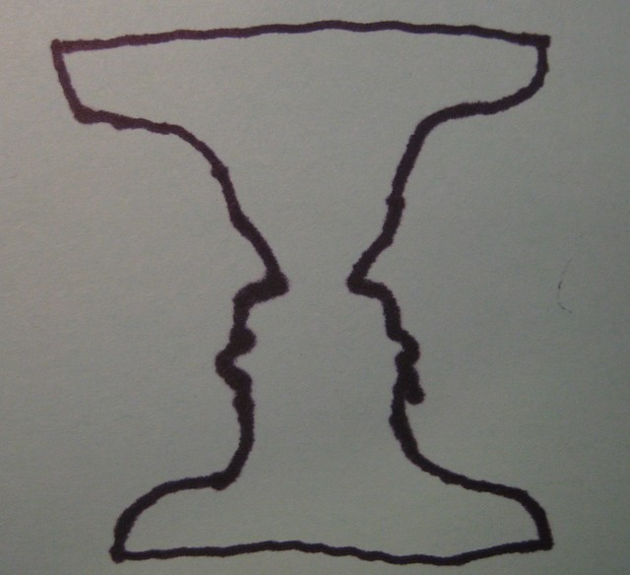
Older people, safety and protection: what we know and what we don’t
Much ASP research is linked to policy and legislation
Service users tend to choose other types of research questions
Lack of studies beginning with older people’s:
Perspectives
Meanings
Priorities
Strengths

Slide 3
Research questions
What do ‘safety’ and ‘vulnerability’ mean to older people living in the community who are supported by health and social care services? How important is safety in their lives?
What resources/sources of support do older people draw on to manage vulnerability and secure safety? What other factors impact on their safety/vulnerability?
How might improvements be made in the ways that older people in the community are able to keep and feel safe?
What might be the best methods of capturing this knowledge?

Slide 4
Methods
STAGE ONE: January 2017 – June 2017
Two focus groups, with total ten participants
Exploring safety & vulnerability using creative methods
Designing methods for stage two
STAGE TWO: July 2017 – July 2018
Five participants each paired with a researcher
Data collection over three month period
Two-way discussions, three-way discussions, guided walks, images, review
STAGE THREE: August 2018 – July 2019
Thematic analysis, supported by two collaborative analysis workshops
Beginning to share findings

Slide 5
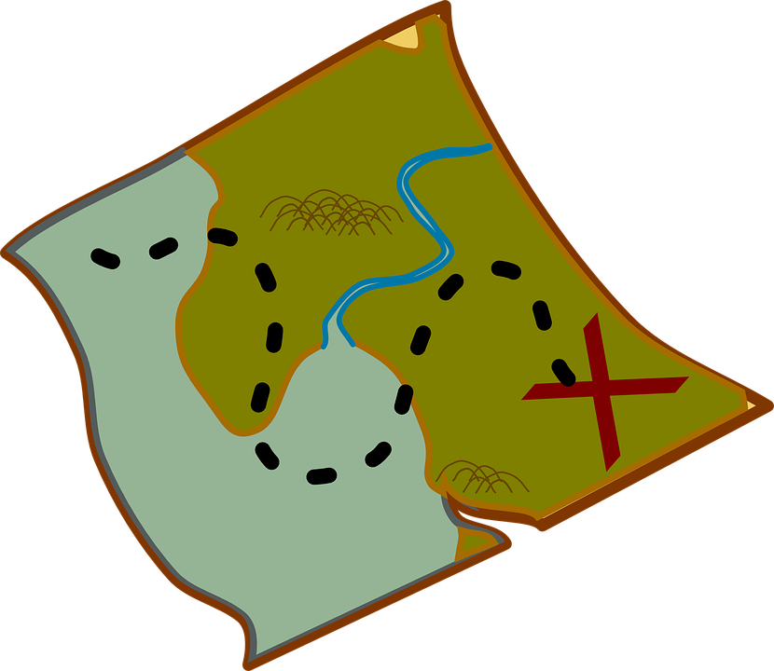
Findings

Slide 6
1. Safety and vulnerability mean different things to different people
But at this point in my life, I'm 65 this year, I do not feel vulnerable in any way, shape or form. And I think it's because of my mental attitude, if that's the right word to use. I think it's because my attitude in life, it's because …I was dragged up instead of brought up. … that's gave me, well, if somebody comes to the door, they're not wanting to do it with me, I'll just tell them straight, I don't care.
Bob, Focus Group 2
…depending on personalities and preferences

Slide 7
1. Safety and vulnerability mean different things to different people
I mean, I do, at times, feel vulnerable. Like, this week, my son’s away, and I know it's not right, but I feel a lost soul when he’s away.
Jane
…but you don't know your neighbours, I don't know who's through the wall from me.
Jack
…depending on relationships and communities

Slide 8
1. Safety and vulnerability mean different things to different people
Carol: Sometimes I bump into people and I don’t want to. …
Researcher: Yes. So, that makes you feel bad.
Carol: It makes me feel nervous.
…depending on environment

Slide 9
1. Safety and vulnerability mean different things to different people
…it’s dark and also I feel so much more less able because I get very tired in the evening as well, … I don’t know what it is that makes you feel more unsafe; probably because you get out of doing it. You don’t do it very often. I expect there’s young people who are out and about in the dark so often and as you get older you probably don’t...
Jean
…depending on experiences over time

Slide 10
2. ‘Keeping safe’ sits alongside older people’s other priorities
Researcher: …how do you feel about living on your own, if I can ask that?
Margaret: Actually, I quite enjoy it, but you're lonely at times.
Dave: Aye.
Margaret: And you feel vulnerable.
Dave: Aye.
Margaret: But I don't want to give it up, yet.
Focus Group 1
…for instance their sense of identity

Slide 11
2. ‘Keeping safe’ sits alongside older people’s other priorities
I said, I couldn’t do that to him, I couldn’t go to my bed and sleep at night, knowing that I'd put him into a place that he hated.
Jane
…there’s fifteen stairs at the back of the house I can get down… I don’t go… Jane doesnae like me going out.
Harry
…for instance their relationships

Slide 12
3. People focused on their own skills and resources
I know a lot of people come to me if they’re going to have a scooter because they think I’ve got a bit of, you know…
Jean
But as time goes on, as I found out, you have to re-evaluate …you say, well, I can't do that anymore, but I can still do this.
Dave, Focus Group 2

Slide 13
4. Family, professionals, communities
Researcher: Because I remember when we were in the shops and you were sitting down and the check out guy was trying to push through and the lady behind you, she turned round and said, take your time. You know, I thought that was really lovely.
Jean: It is that… yesterday I was in and then one, the one behind came and helped me with my bags. You know it is good when people do that, you know.
…were also drawn on as resources

Slide 14
4. Family, professionals, communities
And one came, and she was a young girl.… And I've no doubt she’s got all her qualifications, but it was like talking to a book, you know. And I thought, no, I don't really want this, I don't want bogged down with this. So I phoned [name], and I said to her, I don't think this is gonna work. I said, I don't feel a connection with this girl….whereas I've only spoken to you on the phone, but I feel I'm on the same wavelength.
Jane
…could require active negotiation
and/or could be experienced as risks

Slide 15
Linking to formal ASP processes
In/ability to safeguard takes place in a complex context:
personalities and preferences;
relationships;
environments;
experiences over time.
Council officers can be perceived as a threat or an opportunity; much depends on
Understanding the adult’s hopes and sense of self, as well as the danger they are in;
Protection plans work best when they are negotiated.

Slide 16
More information
Project website, with links to visual and audio resources: https://feelingsafefeelingvulnerable.stir.ac.uk
Contact:
f.c.sherwood-johnson@stir.ac.uk
k.j.mackay@stir.ac.uk

